Slide 1

Modelling a Transmission Line through Monte Carlo Simulations
Saul Diaz & Ricardo Gares

Slide 2


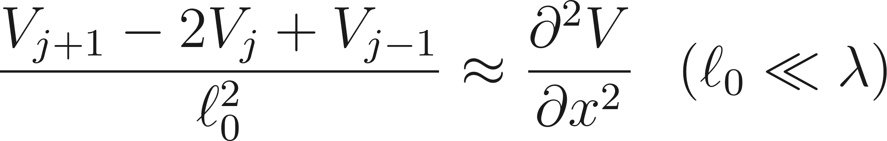
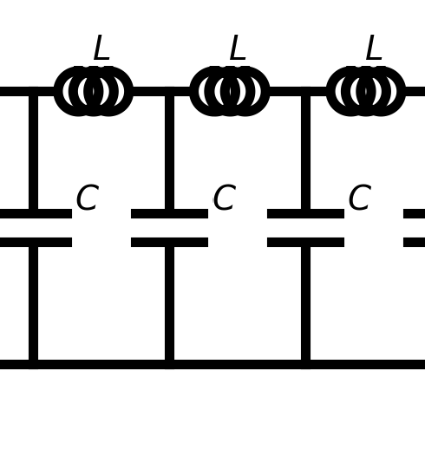
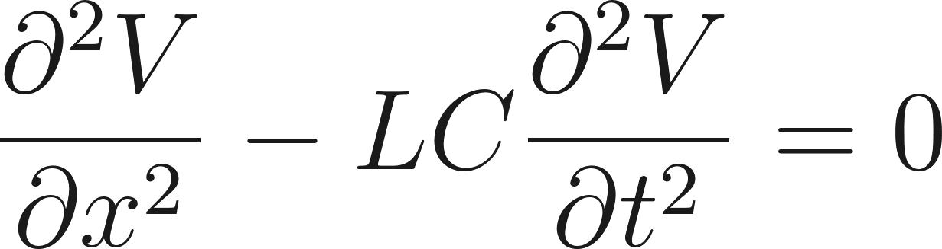
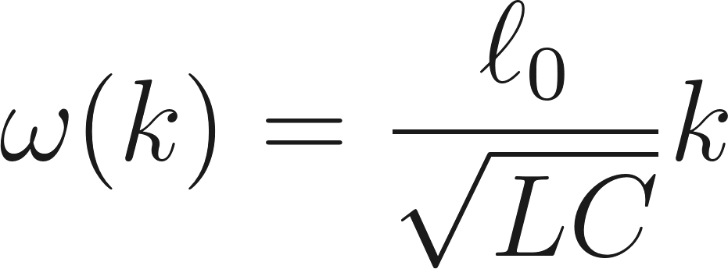




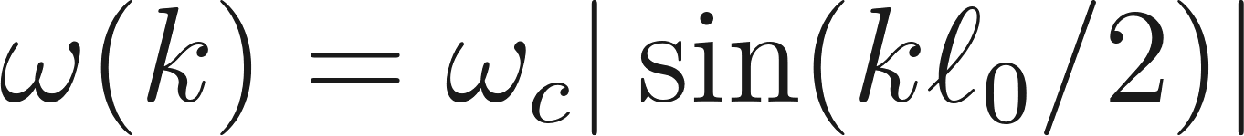
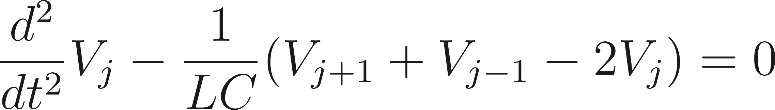
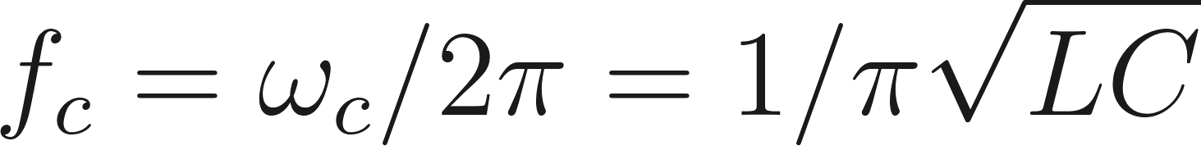
Introduction
Continuous & infinite line [2,3]:
L-C ladder network [1] :
Dispersion relation:
Discrete & infinite line [4]:
Dispersion relation:
Cut-off frequency:

Slide 3

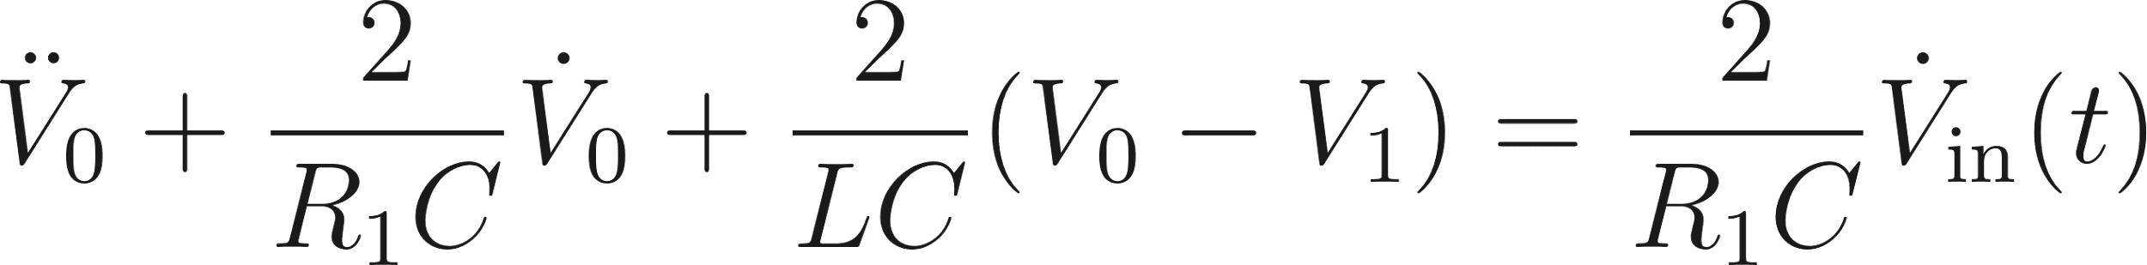
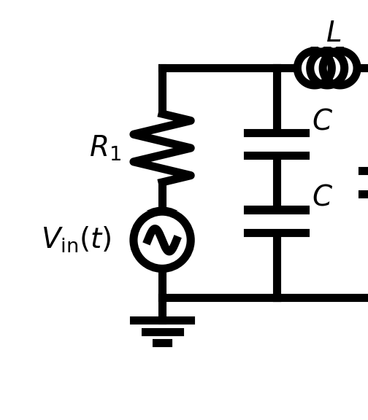
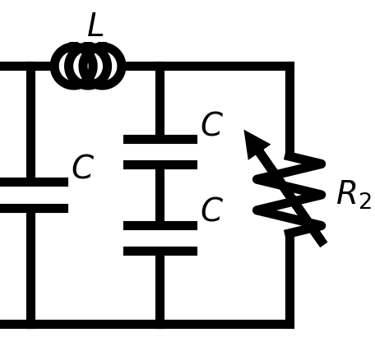
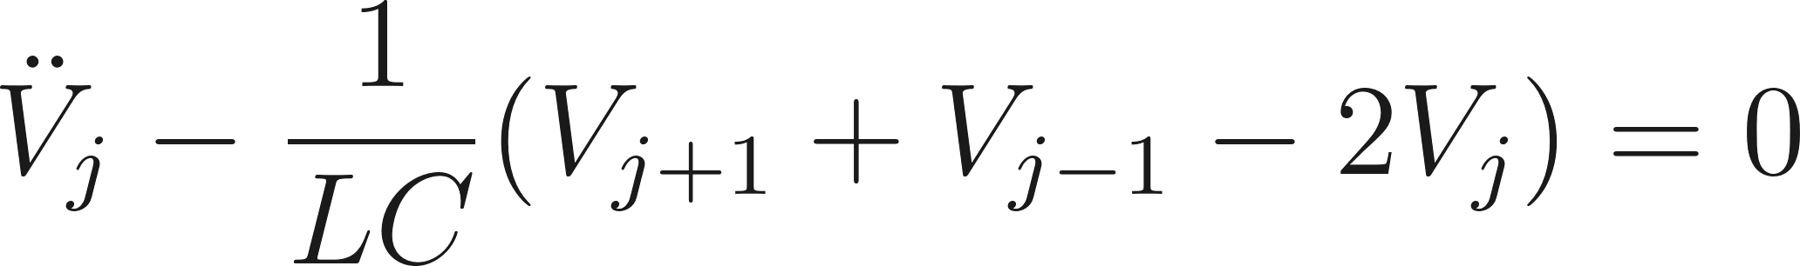
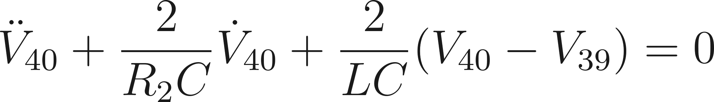
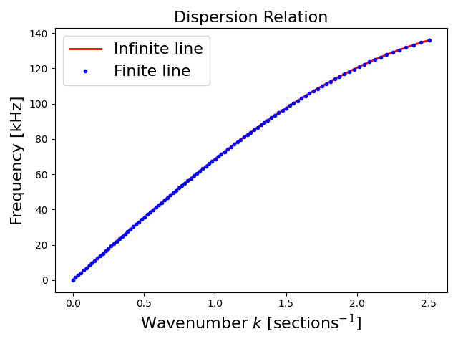
Discrete & finite line [3]:
Research questions:
Which model yields a lower root mean squared error for the dispersion relation compared to experimental data?
Will the measured amplitude ratio between nodes 0 and 40, as a function of frequency, yield a p value greater than 0.05 when compared with the simulation?

Slide 4
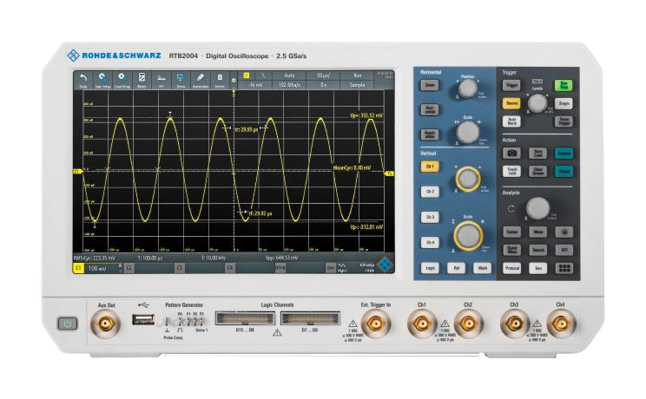
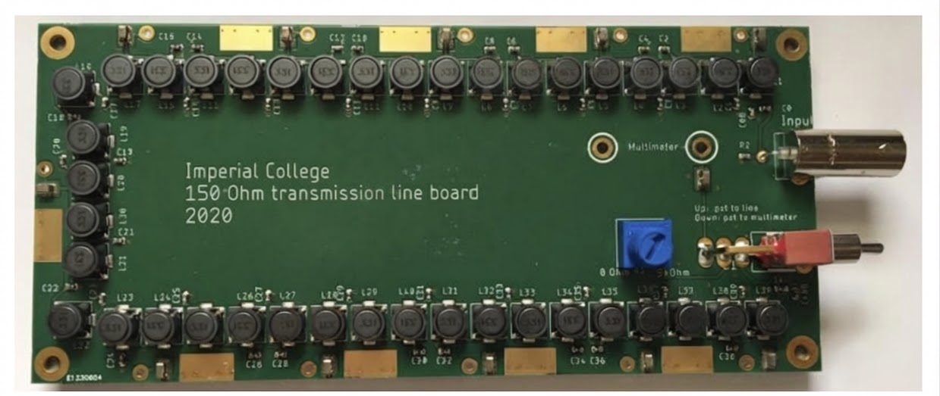
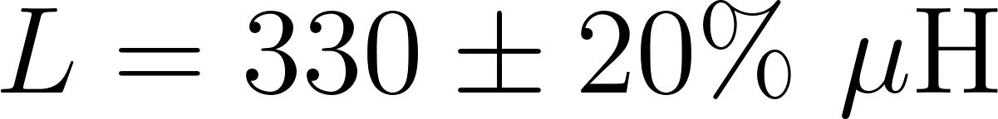

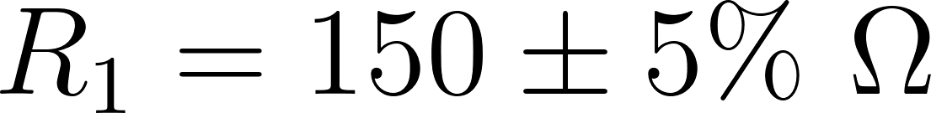
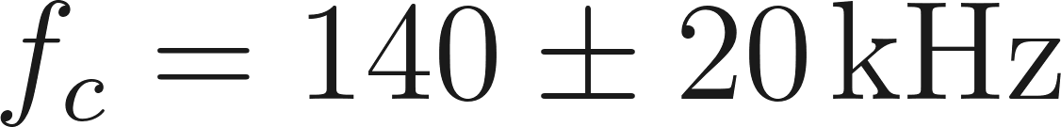
Experimental Setup
C
Node 0
Variable resistor
L
Node 40
Transmission line circuit made of 40 sections
Oscilloscope Rohde & Schwarz model RTB2004
Two BNC probes
A digital multimeter
Coaxial BNC cables
[5,6]

Slide 5
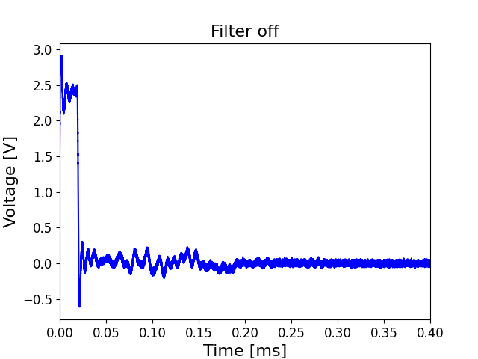
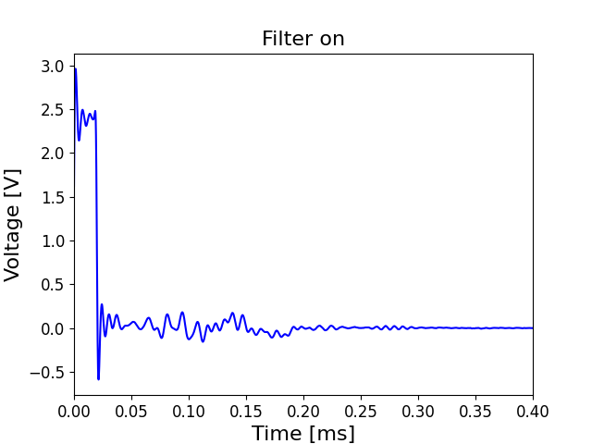
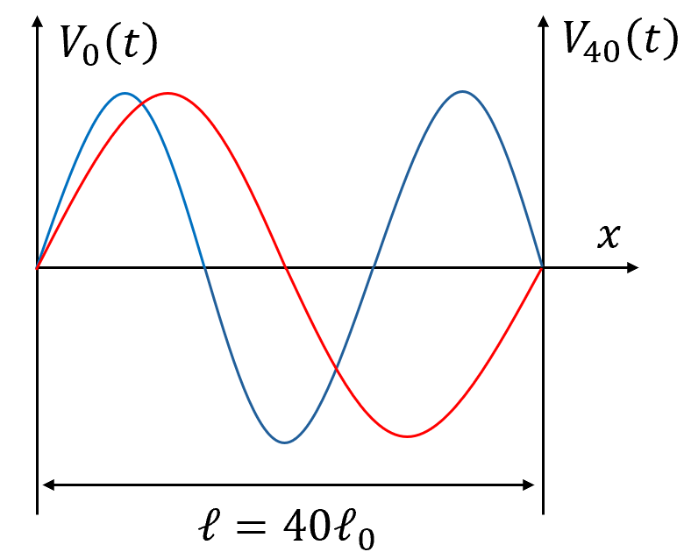
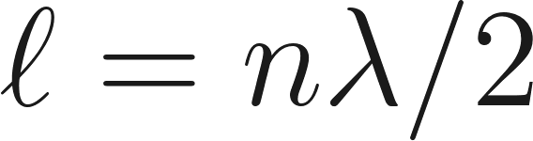
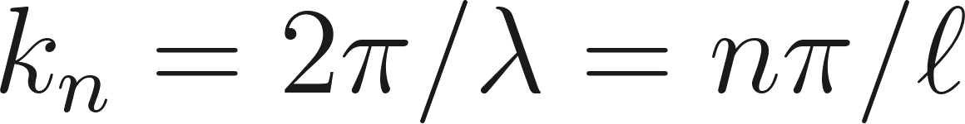
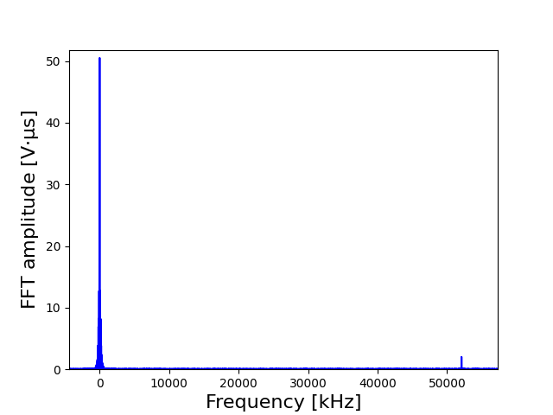
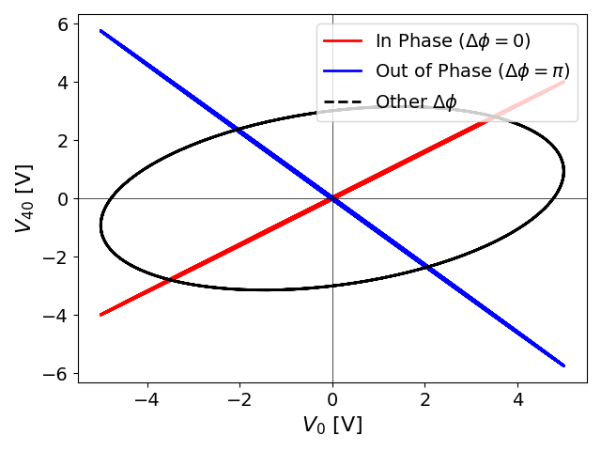

Methods & Data Analysis
Butterworth filter [7]:
Measuring the dispersion relation [6]:

Slide 6
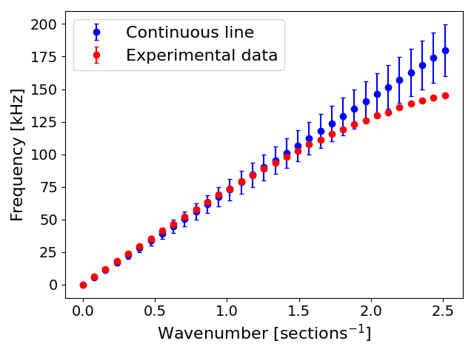
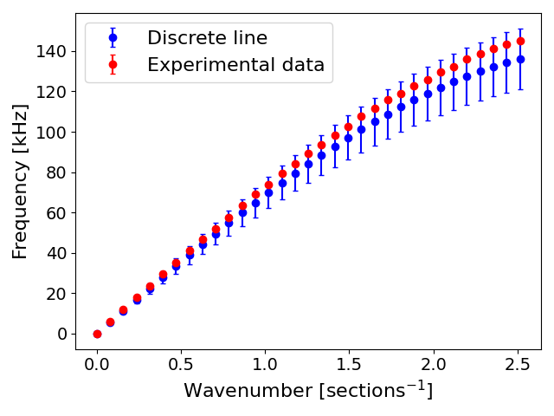
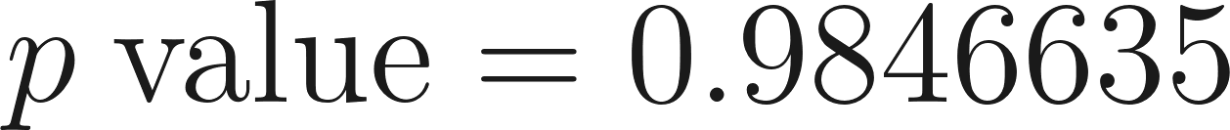
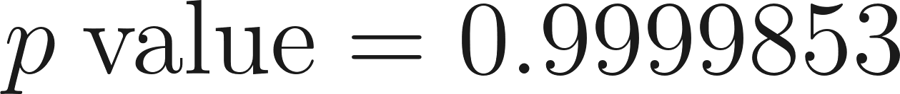
Results & Discussion: Dispersion Relation

Slide 7
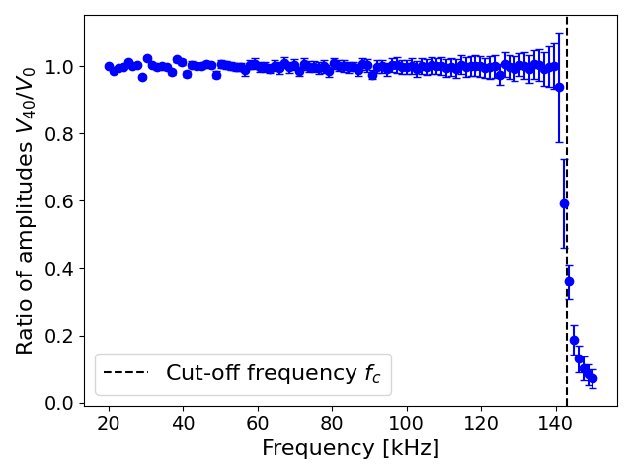
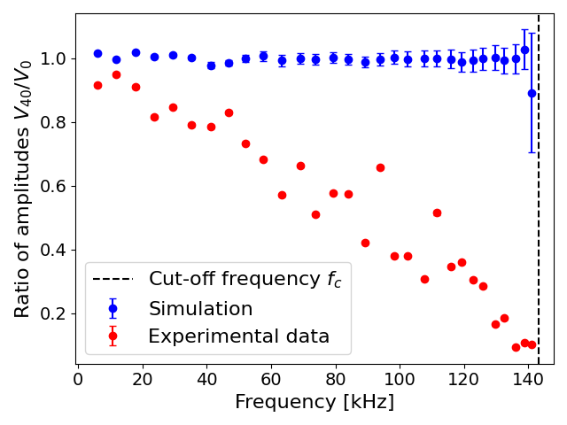
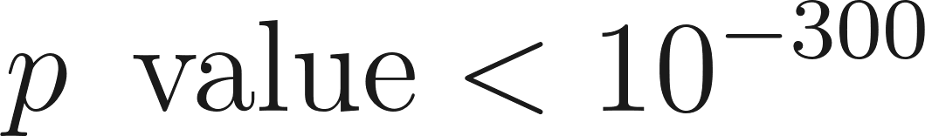
Results & Discussion: Ratio of Amplitudes
Characteristic impedance of the line [1]:
Simulation:
Experiment:

Slide 8
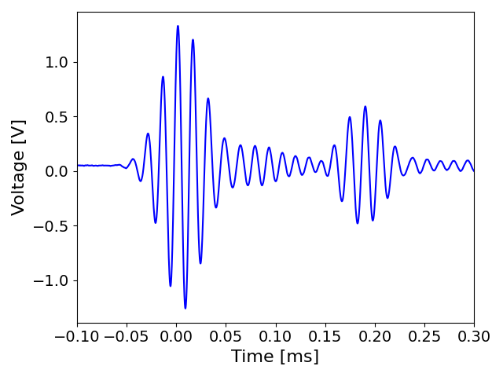
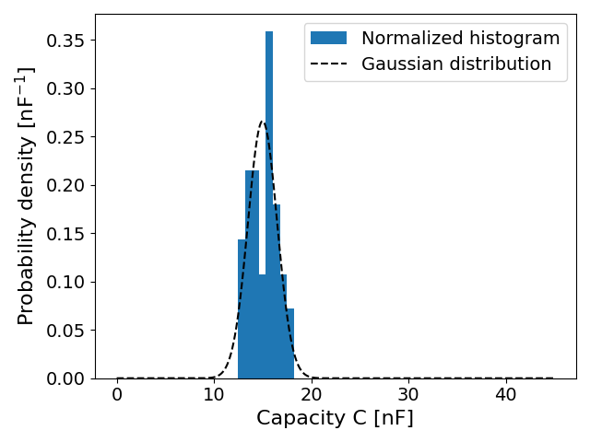
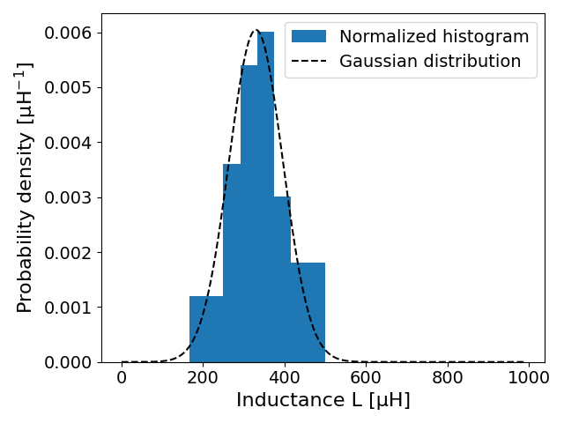
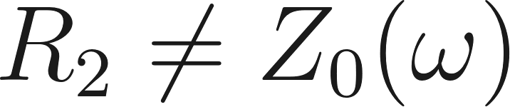
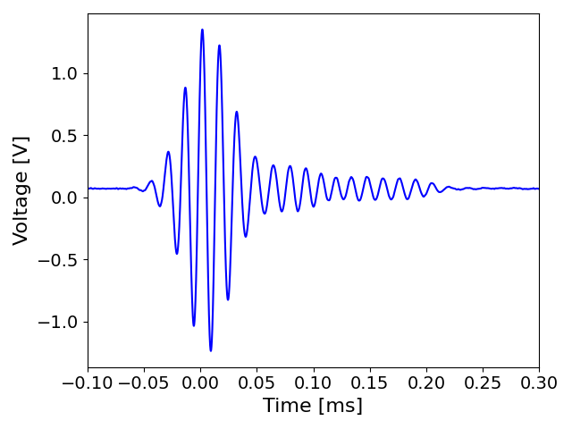
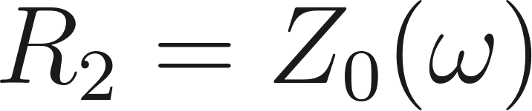
Results & Discussion: Monte Carlo Simulation
Internal reflections:
Gaussian distribution of C’s and L’s:

Slide 9
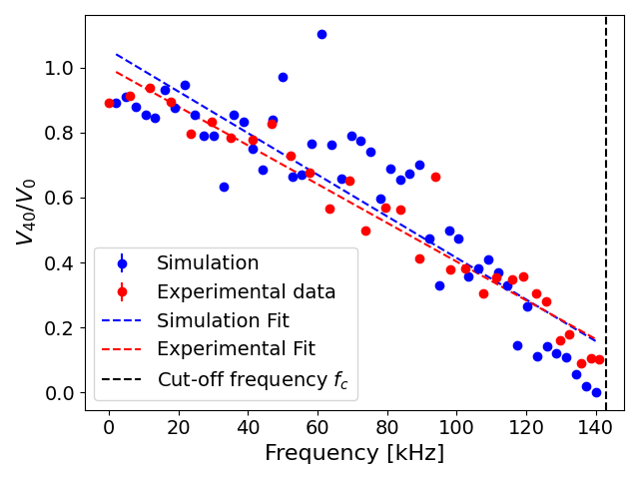
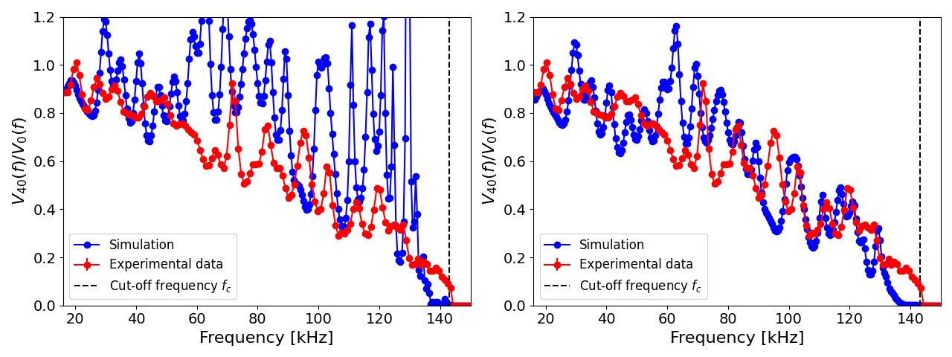
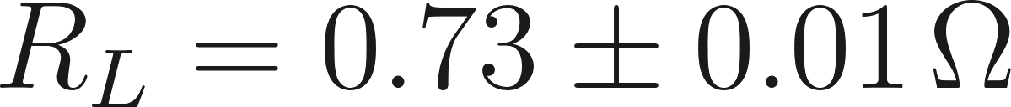
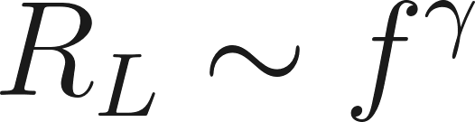

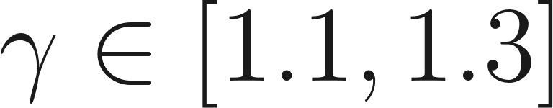
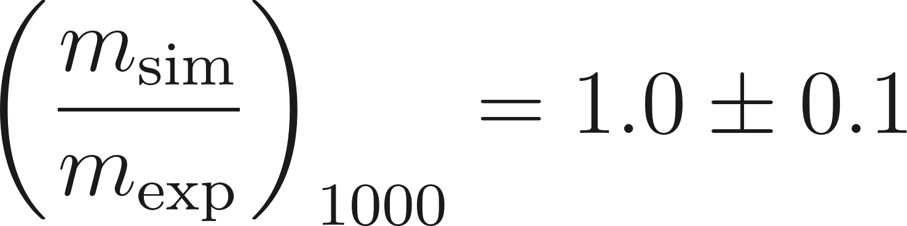

Results & Discussion: Monte Carlo Simulation
Sinusoidal input:
Gaussian input:
[5,8]

Slide 10
Conclusion
References
Dispersion relation:
Ratio of amplitudes:
Continuous line:
Discrete line:
[1] Richard P. Feynman, Robert B. Leighton, and Matthew Sands. The Feynman Lectures on Physics, Vol. II: The Electromagnetic Field. Addison-Wesley, 1964.
[2] John R. Taylor. Classical Mechanics. University Science Books, 2005. See Chapter 16 for the Wave Equation in Continuous Media.
[3] Mark Newman. Computational Physics. CreateSpace Independent Publishing Platform, 2013. Includes numerical solutions for the heat and wave equations.
[4] Thornton, S. T. and Marion, J. (2019). Classical dynamics of particles and systems, pages 498–507. MTM.
[5] Bourns. SRR7045 Series - Shielded SMD Power Inductors, 2013. Rev. 02/13.
[6] Charles Baynham and Richard Hobson. 2nd Year Lab - Thermal and Electrical Waves Experiment Script. Blackett Laboratory, Physics Department, Imperial College London, 2025.
[7] Paul Horowitz and Winfield Hill. The Art of Electronics. Cambridge University Press, Cambridge, 3rd edition, 2015. pp. 1109–1110.
[8] Muhlethaler, J., Biela, J., Kolar, J. W., and Ecklebe, A. (2011). Improved core-loss calculation for magnetic components employed in power electronic systems. IEEE Transactions on Power electronics, 27(2):964–973.

